Slide 1
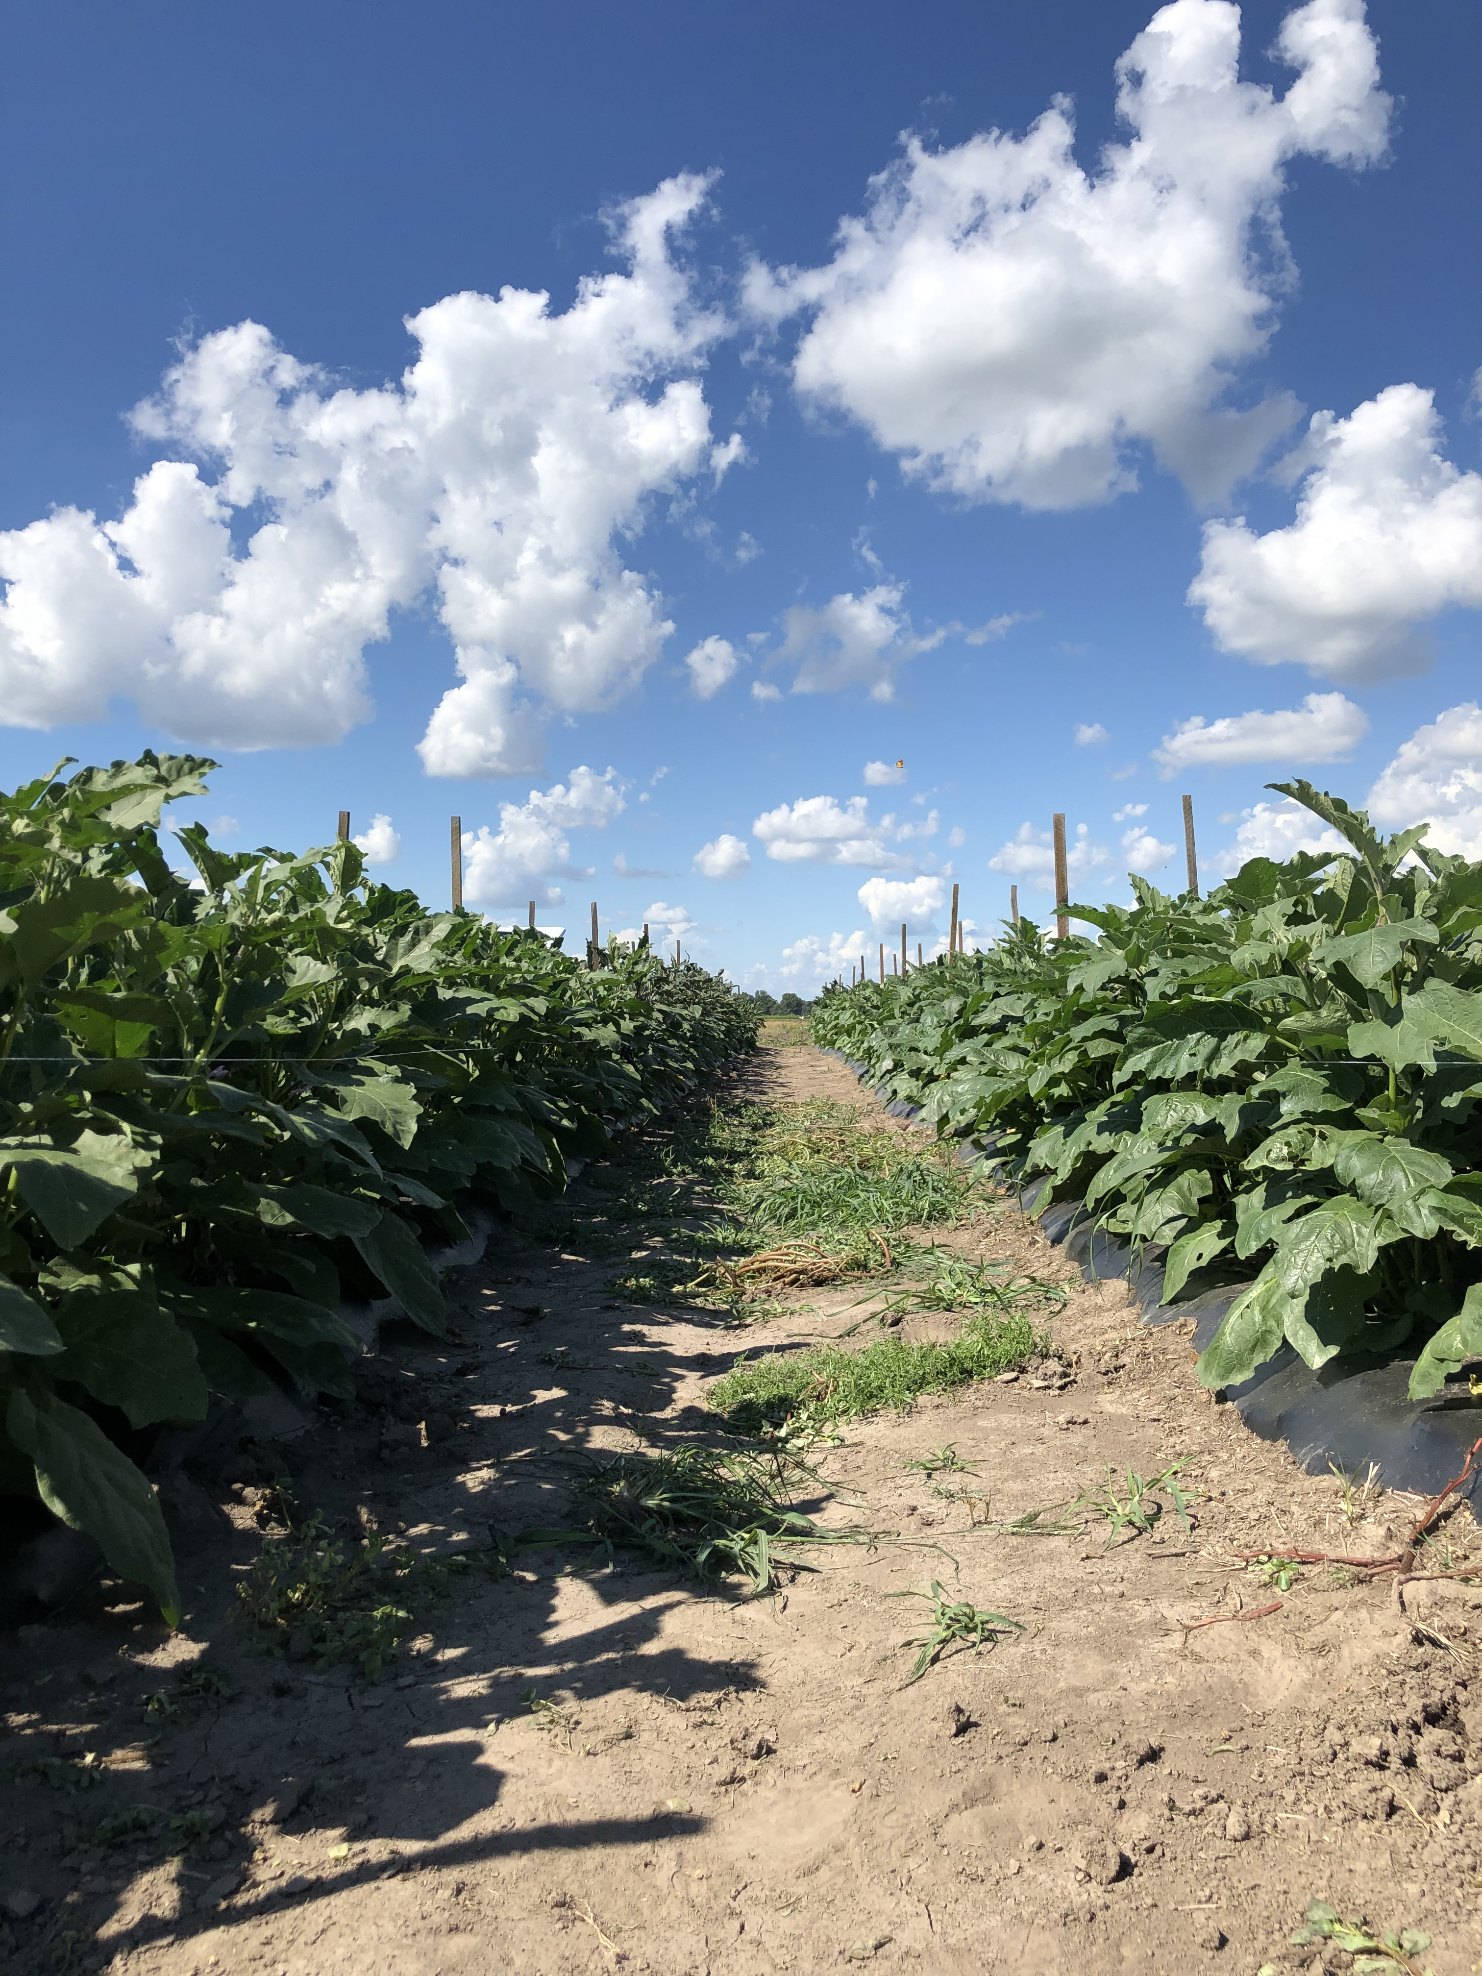
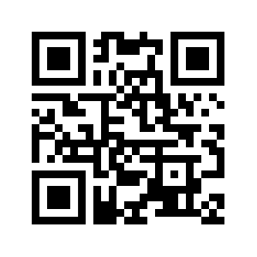

Slide 2
Read the latest issue NOW!

Slide 3
Subscribe to the Vegetable Crops Hotline Newsletter to receive up-to-date information about vegetable production and farm management from Purdue specialists and guest authors. Or search our extensive database.
Sign up for an electronic newsletter alert by sending an email to
vch-subscribe-request@lists.purdue.edu
or
Ask your County Educator for a form to sign up for a hard copy that is sent by U.S. Mail.

Slide 4
Subscribe to the Vegetable Crops Hotline Newsletter to receive up-to-date information about vegetable production and farm management from Purdue specialists and guest authors. Or search our extensive database.
Sign up for an electronic newsletter alert by sending an email to
vch-subscribe-request@lists.purdue.edu

Slide 5
Subscribe to the Vegetable Crops Hotline Newsletter to receive up-to-date information about vegetable production and farm management from Purdue specialists and guest authors. Or search our extensive database.
Ask your County Educator for a form to sign up for a hard copy that is sent by U.S. Mail.
or
Call 812-886-0198

